Slide 1
Stock Price Prediction
Team Members :
18IT401 – Smit Ghelani
18IT410 – Parth Panchani
18IT427 – Jigar Shekhat
Guided by – Prof. Kanu G. Patel

Slide 2

Outlines :
What is Stock Price Prediction ?
Why Stock Price Prediction needed ?
How it Works ?
Python’s Modules
Advantages & Disadvantage

Slide 3
What is Stock Price Prediction ?
Stock price prediction is the act of trying to determine the future value of a company stock or other financial instrument traded on an exchange.
The successful prediction of a stock's future price could yield significant profit.
The efficient-market hypothesis suggests that stock prices reflect all currently available information and any price changes that are not based on newly revealed information thus are inherently unpredictable.
Others disagree and those with this viewpoint possess myriad methods and technologies which purportedly allow them to gain future price information.

Slide 4
Why Stock Price Prediction is needed ?
Stock Market Price prediction offers great profit avenues and is a fundamental stimulus for most researchers in this area.
Stock market prediction aims to determine the future movement of the stock value of a financial exchange.
The accurate prediction of share price movement will lead to more profit investors can make.

Slide 5
Why Stock Price Prediction needed ?(con..)
Predicting how the stock market will move is one of the most challenging issues due to many factors that involved in the stock prediction, such as interest rates, politics, and economic growth that make the stock market volatile and very hard to predict accurately.
The prediction of shares offers huge chances for profit and is a major motivation for research in this area; knowledge of stock movements by a fraction of a second can lead to high profits.
Since stock investment is a major financial market activity, a lack of accurate knowledge and detailed information would lead to an inevitable loss of investment.

Slide 6
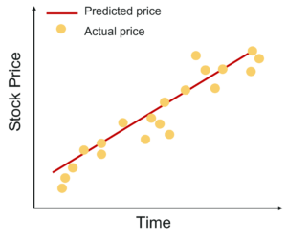
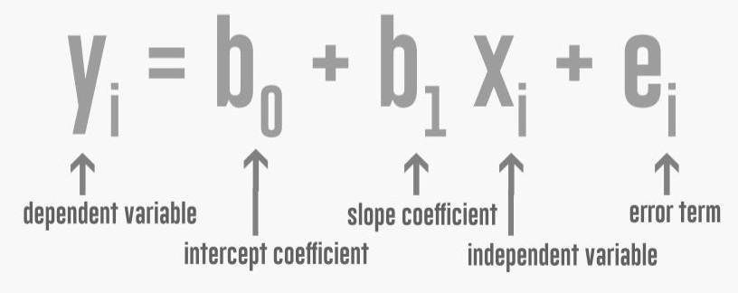
Linear Regression
Linear Regression is an approach for modeling the relationship between a scalar dependent variable y and one or more explanatory variables (or independent variables) denoted X

Slide 7
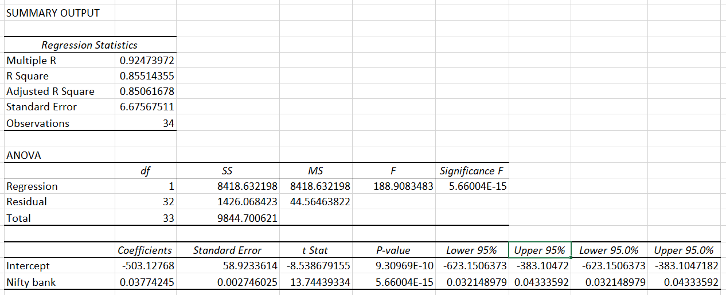
How Linear Regression works ?
we are holding Canara bank stock and want to see how changes in Bank Nifty’s (bank index) price affect Canara’s stock price. Our aim is to find a function that will help us predict prices of Canara bank based on the given price of the index.

Slide 8
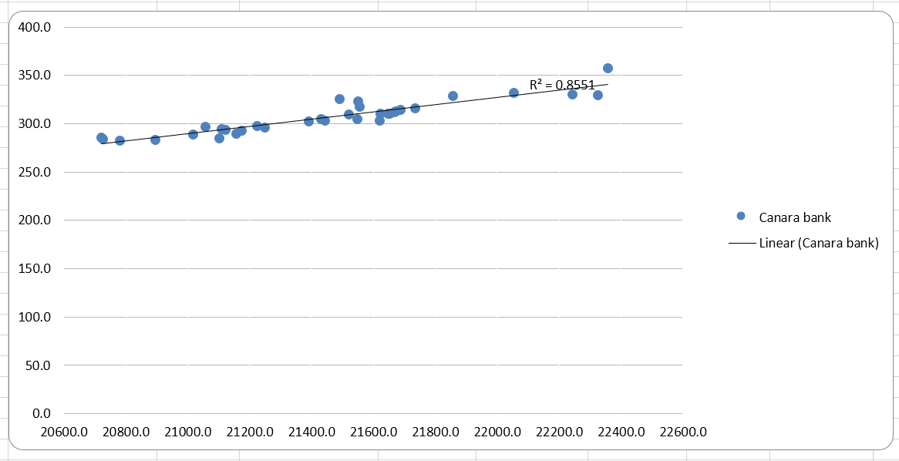
[ regression line which has a coefficient of determination(R²) of 0.85. This means Canara Bank and Bank Nifty are 85% correlated. ]

Slide 9
Date | Nifty Bank | Canara bank | Predicted Data
12-05-2020 | 22671.7 | 366.0 | 358.1
15-05-2020 | 22821.5 | 364.3 | 352.6
16-05-2020 | 22928.6 | 373.1 | 358.2
17-05-2020 | 22935.9 | 374.0 | 362.3
18-05-2020 | 22698.6 | 368.3 | 362.5
19-05-2020 | 22769.8 | 367.6 | 353.6
22-05-2020 | 22652.8 | 361.7 | 356.3
23-05-2020 | 22582.8 | 357.4 | 351.8
24-05-2020 | 22536.3 | 353.1 | 349.2
25-05-2020 | 23190.8 | 358.6 | 347.4
26-05-2020 | 23362.2 | 360.0 | 372.1
29-05-2020 | 23182.8 | 350.6 | 378.6
Looking at the data, we can see the predictions are quite close (considering 85% coefficient), maybe not tradable but this gives us a direction. You can and should further improve this method by adding more than one independent variables. Doing so will help reduce the residual or error and help to get you closer to the actual price.

Slide 10
Python Libraries
Pandas : It is likewise a Python library for information control and examination. Specifically, it offers information structures and activities for controlling numerical table and time arrangement information.
NumPy : NumPy is basically a module or you can say a library that is available in python for scientific computing now it contains a lot of things it contains a powerful dimensional array object.
NsePy : NsePy is a library to extract historical and real-time data from NSE’s website. This Library aims to keep the API very simple.

Slide 11
Python Libraries
Keras : Keras is a minimalist Python library for deep learning that can run on top of Theano or TensorFlow. It was developed to make implementing deep learning models as fast and easy as possible for research and development.
Tensor-flow : TensorFlow is a Python library for fast numerical computing created and released by Google. It is a foundation library that can be used to create Deep Learning models directly or by using wrapper libraries that simplify the process built on top of TensorFlow.
Scikit-Learn : Scikit-learn provides a range of supervised and unsupervised learning algorithms via a consistent interface in Python.It is licensed under a permissive simplified BSD license and is distributed under many Linux distributions, encouraging academic and commercial use.

Slide 12
Advantages & Disadvantage
Forecasts are never 100% accurate. Let's face it: it's hard to predict the future.
It can be time-consuming and resource-intensive
It is country specific (Location Oriented).
It helps customers organize and analyze information in well-structured formats, making it easier to interpret data. Visual learners respond especially well to graphs and often understand the information better than lots of tables. You’ll gain valuable insight
It can print the graph.
We can use it in mobile or pc browser.
Add-free

Slide 13

Thank you

